Slide 1
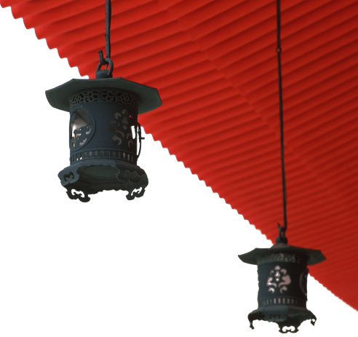

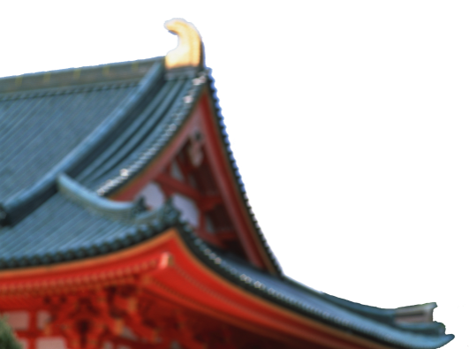
中国文化概况
A GLIMPSE OF CHINESE CULTURE

Slide 2
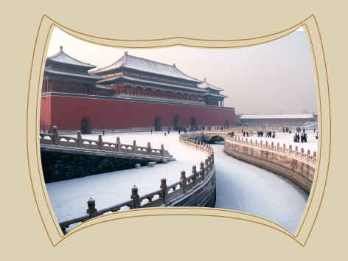
Chapter 11
Major Tourist Cities

Slide 3

学习目标
介绍中国重点旅游城市；
熟悉中国旅游概况。

Slide 4
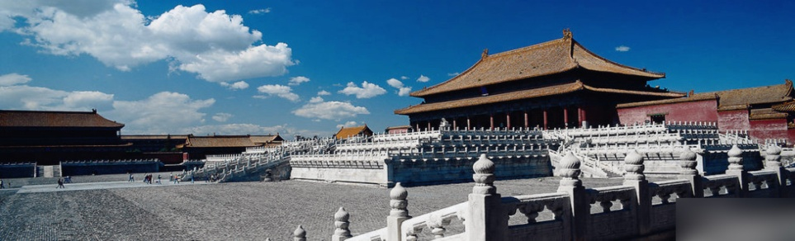
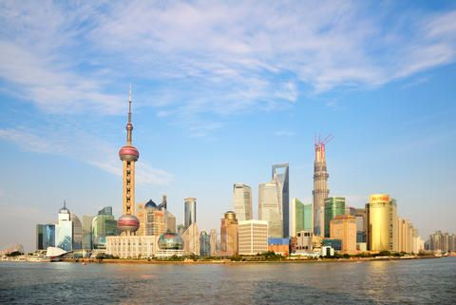
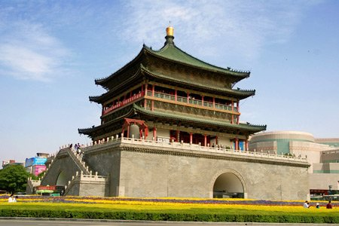
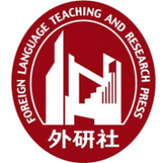
1
2
Overview
3
Lead-in Activity
Chinese Tourism
Discussion &
Presentation

Slide 5


Lead-in Activity
Discuss
Watch the video and discuss the following questions.
1 How do you define “food tourism”?
2 In your mind, does any country stands out at marketing the restaurants in the country? How is China doing in this area?

Slide 6
1
2
Overview
3
Lead-in Activity
Chinese Tourism
Discussion &
Presentation

Slide 7

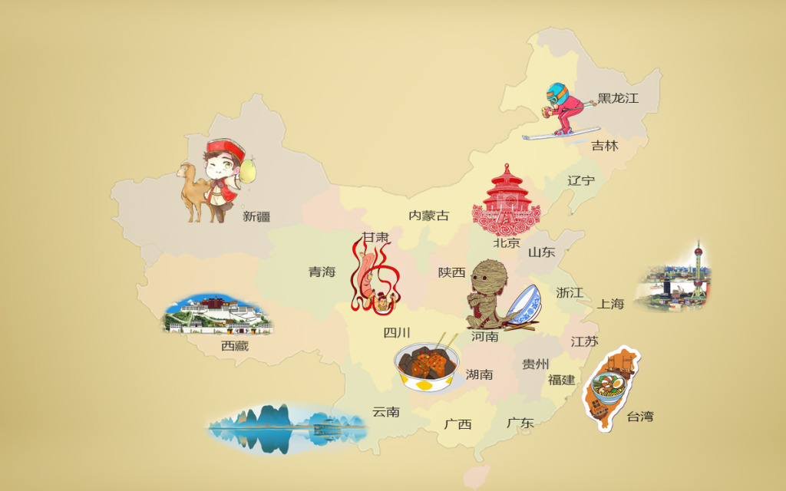



Chinese Tourism
Welcome Aboard:
1 Beijing
2 Xi’an
3 Hangzhou
4 Nanjing
5 Shanghai
6 Kunming
7 Guilin
8 Lhasa
1
2
3
5
8
4
6
7

Slide 8
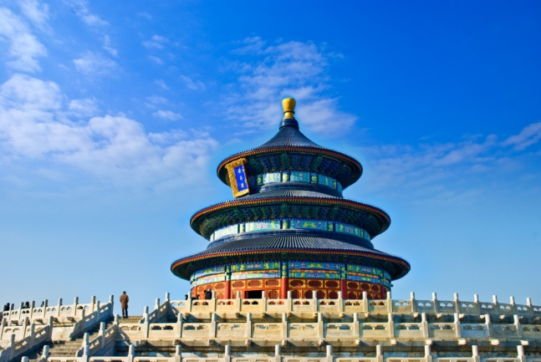
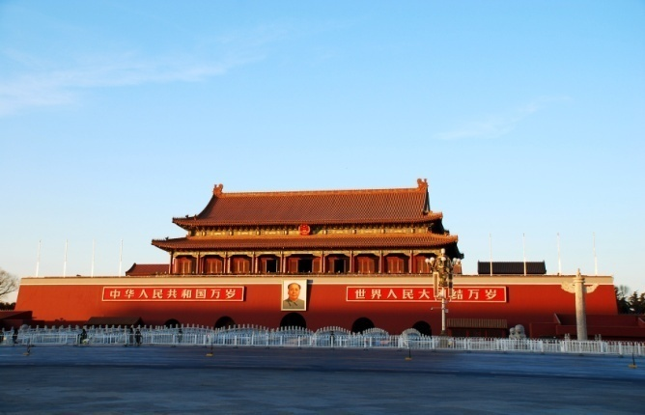
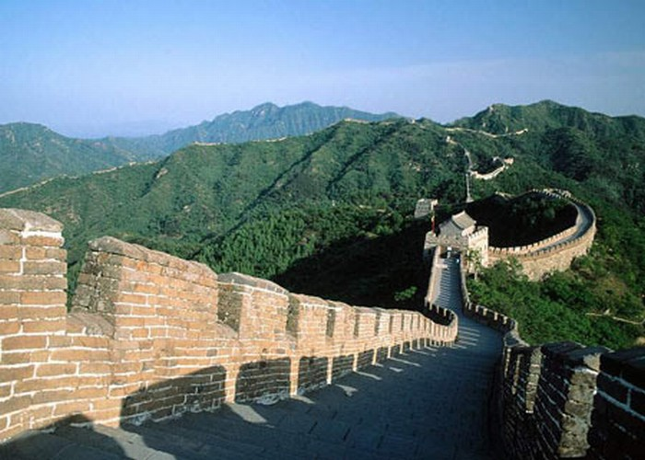
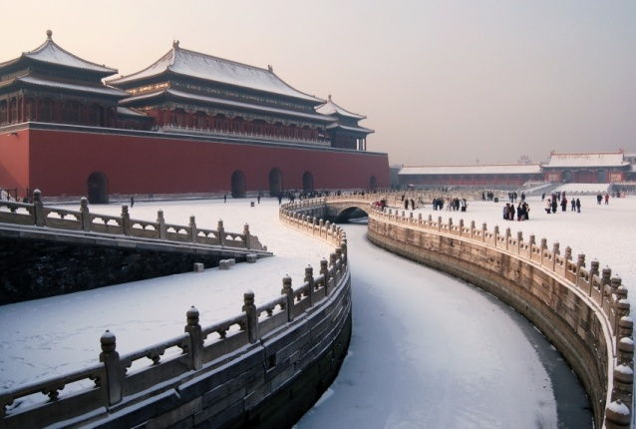
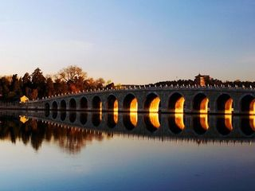
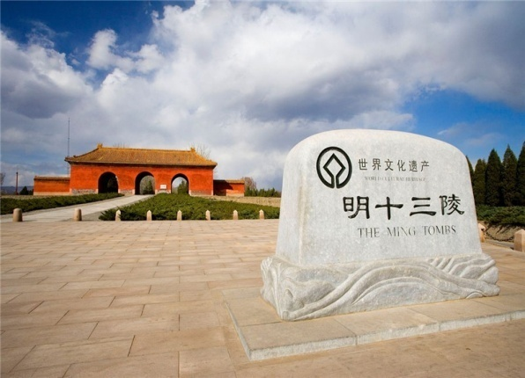
Beijing

Slide 9
Beijing
Forbidden City
Tian’anmen Square
Temple of Heaven
Summer Palace
Great Wall
Ming Tombs

Slide 10
Beijing
Introduction
China’s capital city
located in the northern part of the North China Plain
political and cultural center of China
has about 30 million permanent residents

Slide 11
Beijing
Forbidden City
a vast ancient architectural complex located in
the centre of Beijing
regarded as the finest example of traditional
Chinese architecture
surround by a moat and walls
divided into two parts: the southern section
(outer court) and the northern section (inner
court)
14 emperors of the Ming dynasty and 10
emperors of the Qing dynasty reined in here
listed as World Cultural Heritage Site by UNESCO

Slide 12
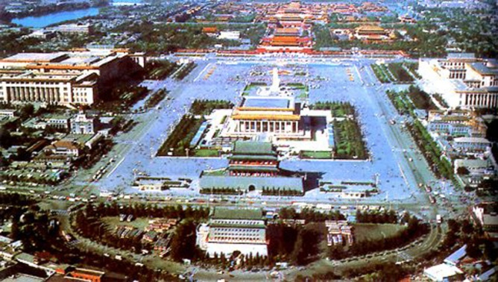
Beijing
Tian’anmen Square
the symbol of New China
North: Tian’anmen Gate Tower
Center: Monument to the People’s
heroes
West: Great Hall of the People
East: National Museum of China

Slide 13
Beijing
Temple of Heaven
situated in the southern part of Beijing
a place where the Ming and Qing
emperors worshipped the god of Heaven
and prayed for good harvests
the structure signifies Heaven and Earth
a cultural museum which merges
architecture, aesthetics, acoustics,
astronomy, calendar, music and dance
into a integral whole

Slide 14
Beijing
Summer Palace
largest imperial garden in the world
initial construction began in 1750
commissioned by Emperor Qianlong as a
birthday gift for her birthday
plundered by foreign troops in 1860 and
innovated by Empress Dowager Cixi in
1886
consists primarily of the Longevity Hill
and Kunming Lake

Slide 15
Beijing
Great Wall
its first major wall was built during the
reign of Emperor Qinshihuang
today’s Great Wall of China was built
during the Ming dynasty
in the aim of protecting people from
raids by northern tribes
a symbol of Chinese character
listed as a World Cultural Heritage Site
by UNESCO in 1987

Slide 16
Beijing
Ming Tombs
situated at the foot of the Heavenly
Longevity Mountain
13 emperors, along with 23 empresses
and other royal families and maids in the
Ming dynasty were buried here
harmony and unity with nature was paid
attention to
reflect the philosophy of “the unity of
heaven and humanity”

Slide 17
Chinese Tourism
Welcome Aboard:
1 Beijing
2 Xi’an
3 Hangzhou
4 Nanjing
5 Shanghai
6 Kunming
7 Guilin
8 Lhasa
1
2
3
5
8
4
6
7

Slide 18
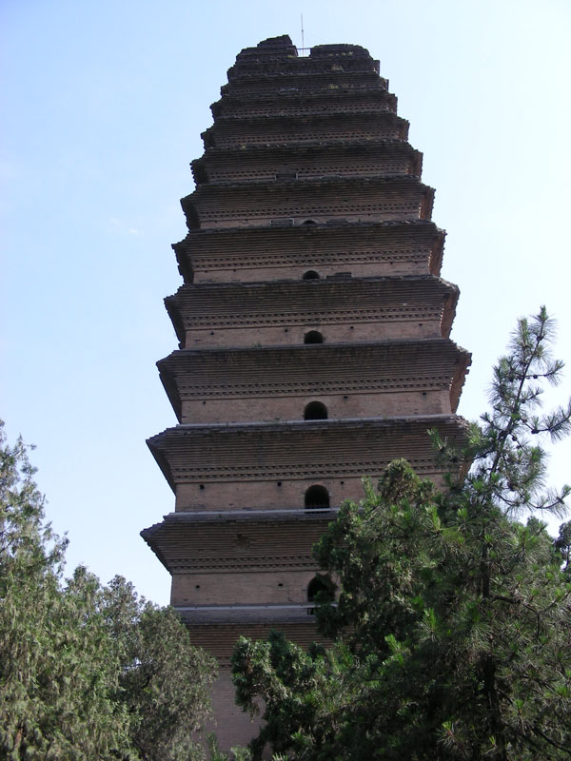
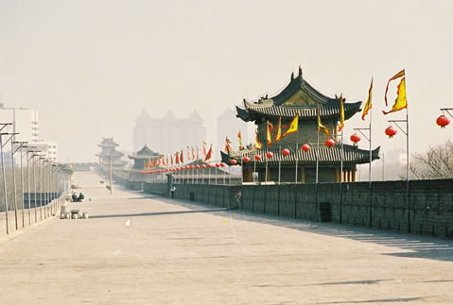
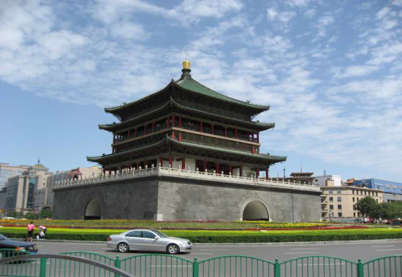
Xi’an
Introduction
the capital of Shaanxi province
has the longest history as China’s capital over
about 10 dynasties
regarded as China’s museum of nature and
history

Slide 19
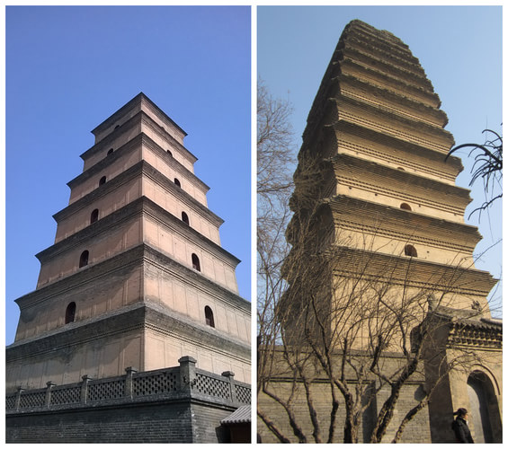
Xi’an
The Big and Small Wild Goose Pagodas
still retain their original appearance
masterpieces of classical Chinese
architecture
The big pagoda has 7 storeys and the
small one has 13 storeys

Slide 20

Xi’an
The Bell Tower
built in the center of the city
now a two-storey wooden structure on a square base
with a panoramic view of the city

Slide 21
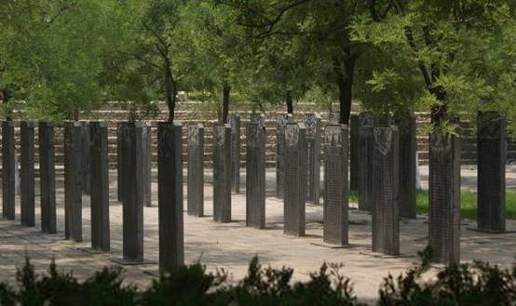
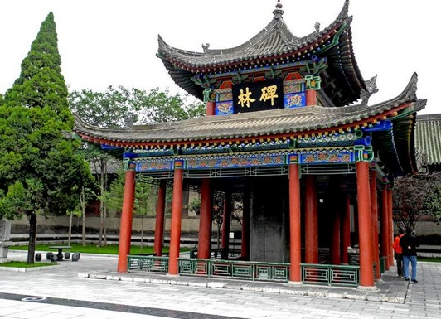
Xi’an
The Forest of Steles
displays the largest number of steles or stone-carved books
covers steles from many dynasties

Slide 22
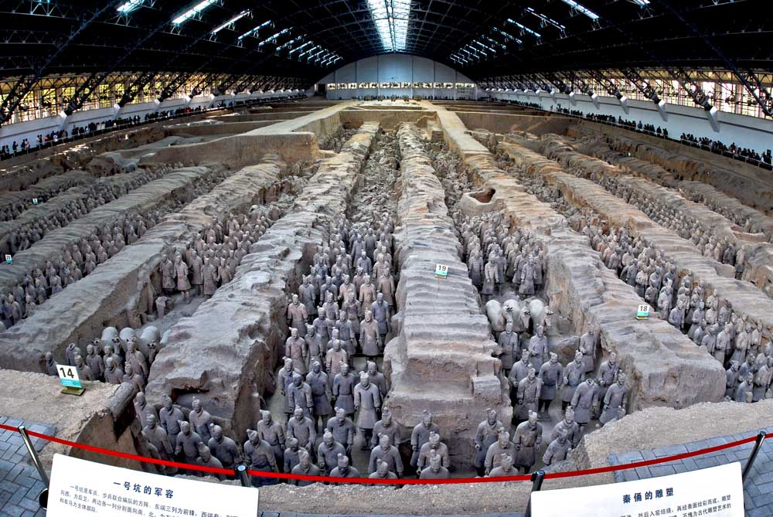
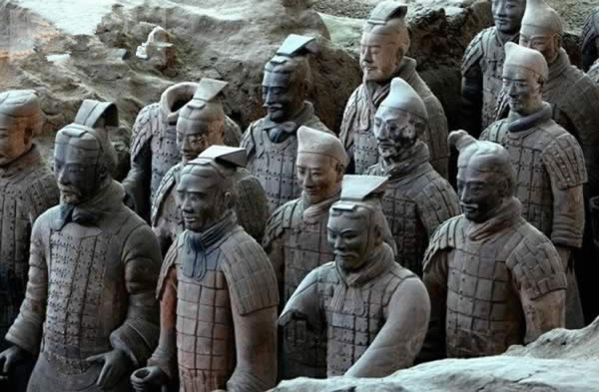
Xi’an
Terracotta Army of Emperor Qinshihuang
built by Emperor Qinshihuang in hope of a better life in the
other world
discovered by farmers in 1974
three pits have been excavated so far

Slide 23
Chinese Tourism
Welcome Aboard:
1 Beijing
2 Xi’an
3 Hangzhou
4 Nanjing
5 Shanghai
6 Kunming
7 Guilin
8 Lhasa
1
2
3
5
8
4
6
7

Slide 24
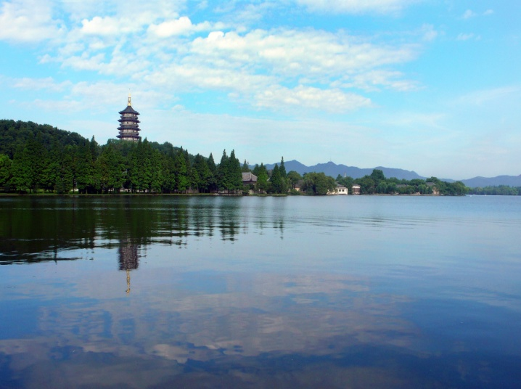
Hangzhou
West Lake
situated in the west of Hangzhou
known for its 10 famous attractions

Slide 25
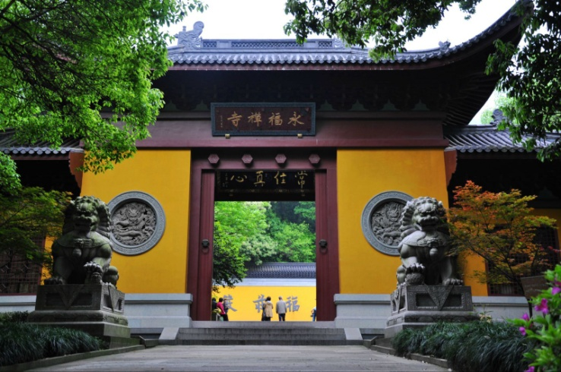
Hangzhou
Lingyin Temple
built by Master Huili, a monk from Western India in the Jin
dynasty
with beautiful scenery and many historic relics

Slide 26
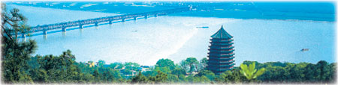
Hangzhou
Pagoda of Six Harmonies
stands on the northern bank of the Qiantang River
about 60 meters high and is built of wood and bricks
with a good view of Qiantang River and the surrounding fields

Slide 27
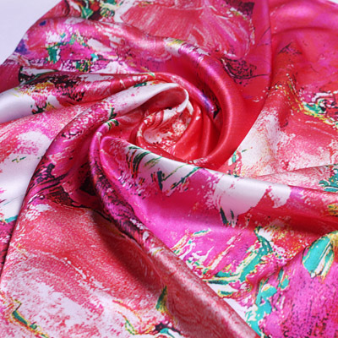
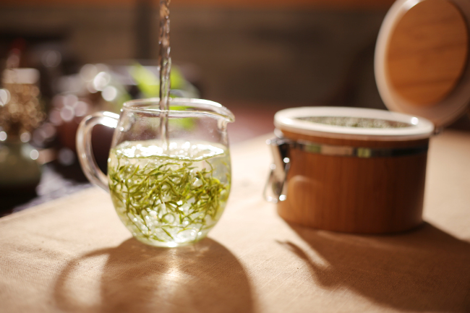
Hangzhou
Hangzhou’s Silk and Tea
Hangzhou being the home of silk in China
silk being famous for the soft, fine, and smooth texture
tea being famous for fragrance, luscious flavor, pleasant leaf
shape, and emerald color

Slide 28
Chinese Tourism
Welcome Aboard:
1 Beijing
2 Xi’an
3 Hangzhou
4 Nanjing
5 Shanghai
6 Kunming
7 Guilin
8 Lhasa
1
2
3
5
8
4
6
7

Slide 29
Nanjing
Introduction
capital of Jiangsu province
second largest international trading port after Shanghai
in the Yangtze River delta
described as “a birthplace of southern beauties and a
habitat of royal rulers”

Slide 30
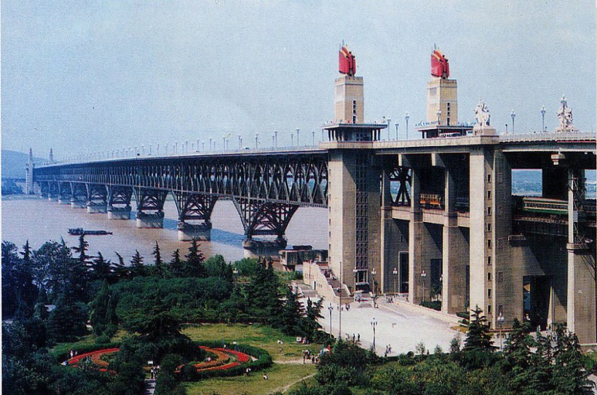
Nanjing
Nanjing Yangtze River Bridge
a double-decked bridge
with a four-lane, 4589-meter-long highway and 6772-meter-
long double railroad tracks

Slide 31
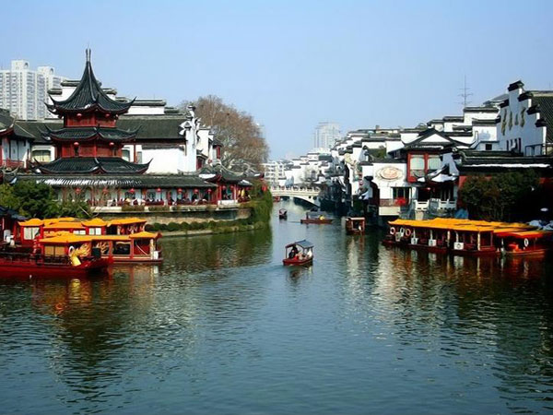
Nanjing
Confucius Temple
used for consecrating and worshipping Confucius
built during the Song dynasty and expanded in the Eastern Jin
dynasty
the surrounding area forms into a picturesque disorder along
the Qinhuai River

Slide 32
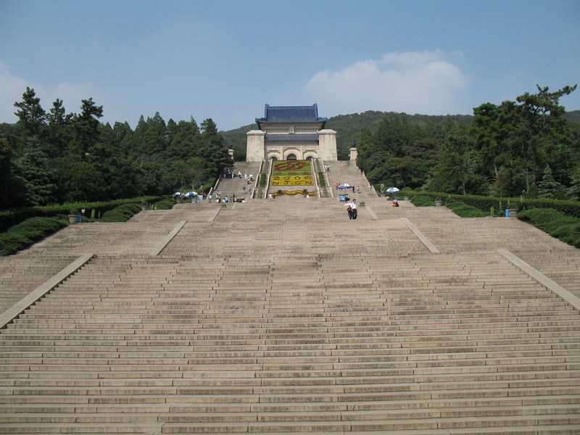
Nanjing
Dr. Sun Yat-sen’s Mausoleum
considered the holy land by Chinese
people
includes the memorial archway, the
tomb passage, the mausoleum gate, the
stele pavilion, the sacrificial hall and the
coffin chamber
with 392 ascending steps

Slide 33
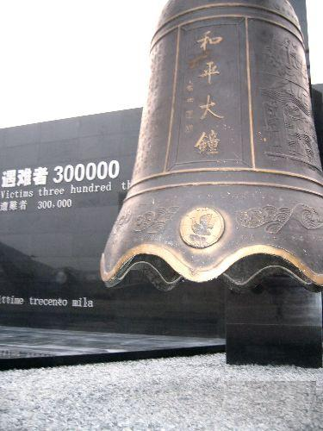
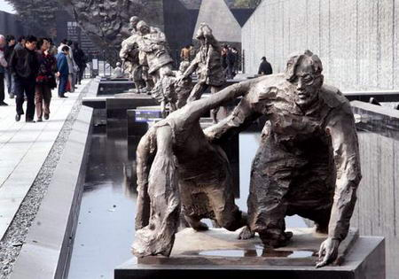
Nanjing
Memorial Hall of the Victims in Nanjing Massacre by Japanese Invaders
built to commemorate the victims of Nanjing Massacre
with a feeling of solemnity and reverence
showcases historical records and objects

Slide 34
Chinese Tourism
Welcome Aboard:
1 Beijing
2 Xi’an
3 Hangzhou
4 Nanjing
5 Shanghai
6 Kunming
7 Guilin
8 Lhasa
1
2
3
5
8
4
6
7

Slide 35
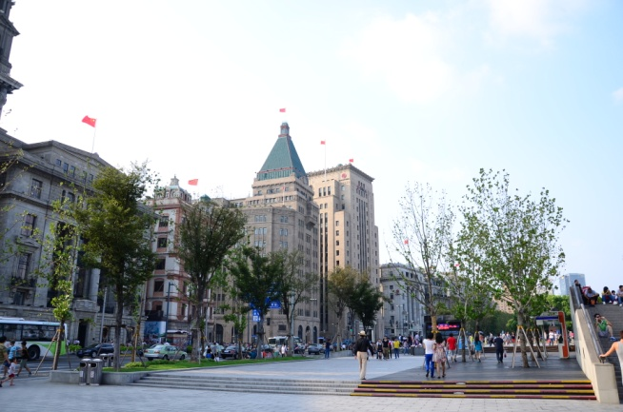
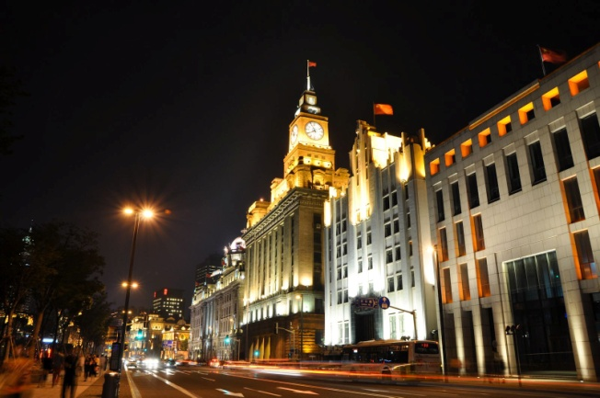
Shanghai
The Bund
refers to the 1.5-km-long belt along the Huangpu River
a symbol of Shanghai
with dozens of European-style buildings
with the name of “Gallery of World Architecture”
more beautiful at night with lights on

Slide 36
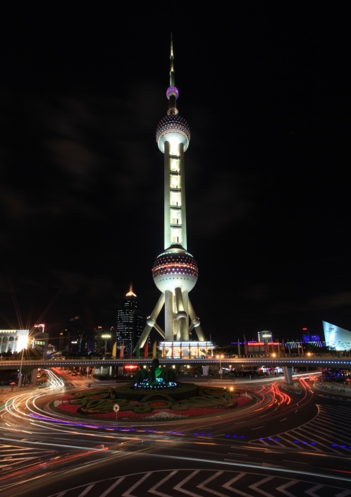
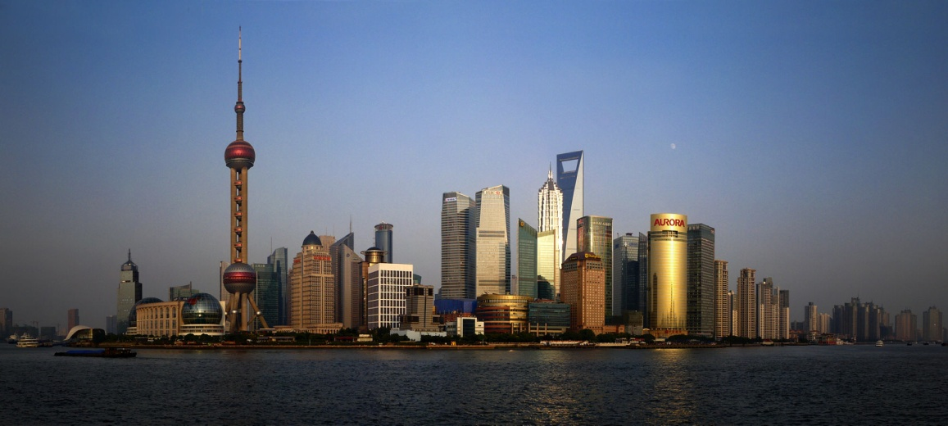
Shanghai
Oriental Pearl TV Tower
at the tip of Lujiazui, opposite to the Bund
468 meters tall, used to be the tallest structure in the
Chinese mainland till 2008
with 15 observatory levels

Slide 37
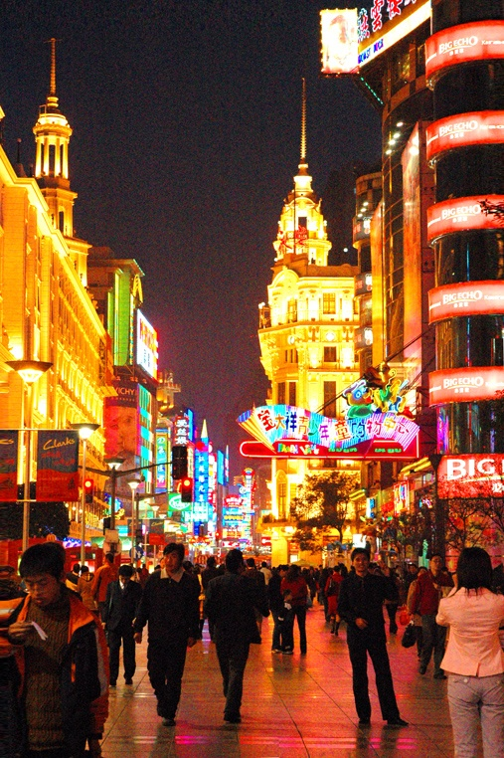
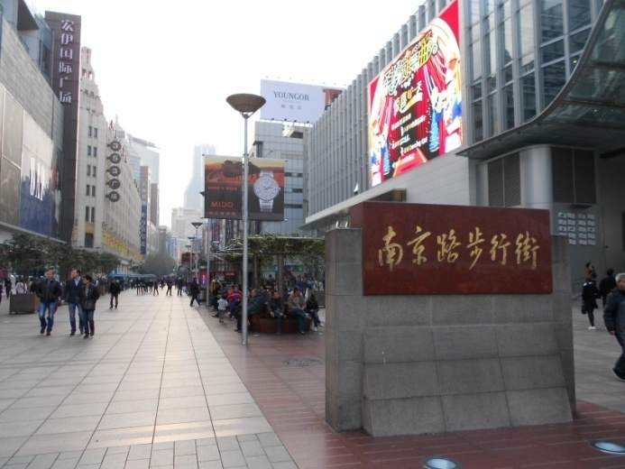
Shanghai
Nanjing Road Pedestrian Walkway
famed as “No. 1 Street in China”
with more than 600 shops on both sides of the walkway

Slide 38
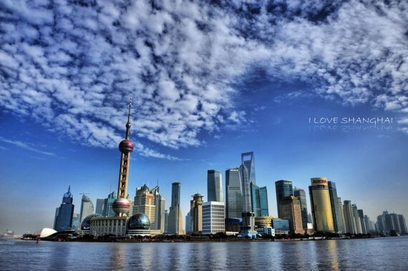
Shanghai
Pudong New Area
situated on the east coast of the Huangpu River
at the intersection of China’s coastal belt for opening up and the Yangtze River estuary
includes four areas

Slide 39
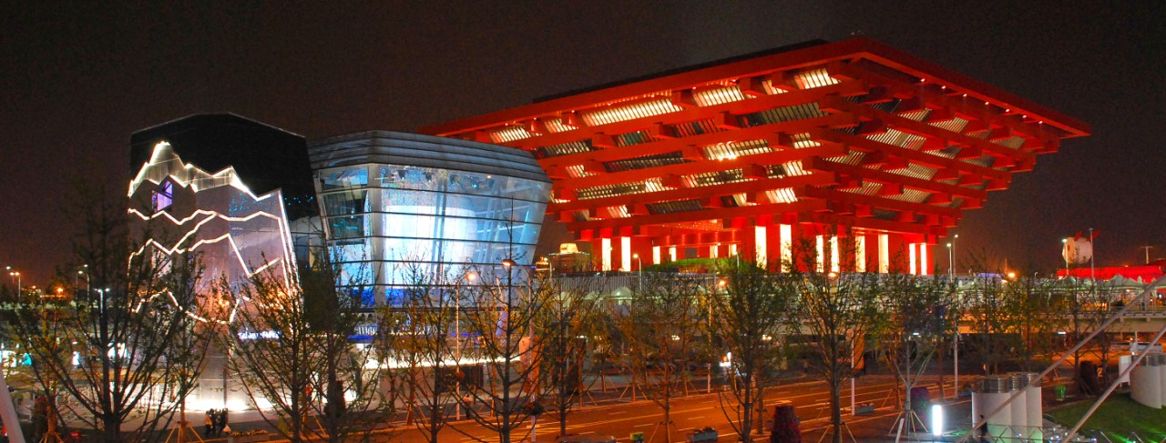
Shanghai
Shanghai and the 2010 World Exposition
Shanghai held the 2010 World Explo
with the them of “Better City, Better Life”
the largest one in the event history

Slide 40
Chinese Tourism
Welcome Aboard:
1 Beijing
2 Xi’an
3 Hangzhou
4 Nanjing
5 Shanghai
6 Kunming
7 Guilin
8 Lhasa
1
2
3
5
8
4
6
7

Slide 41
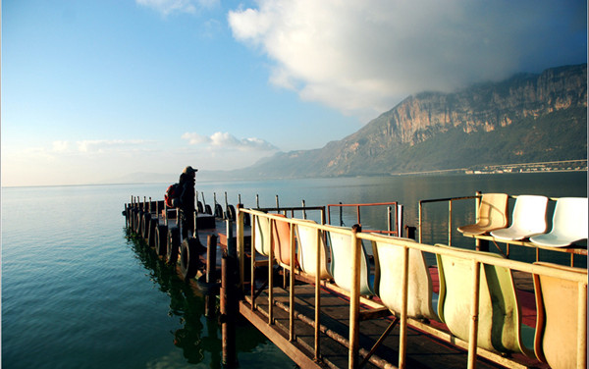
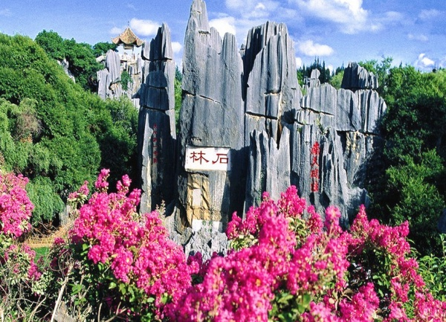
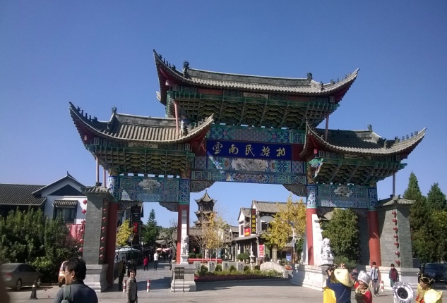
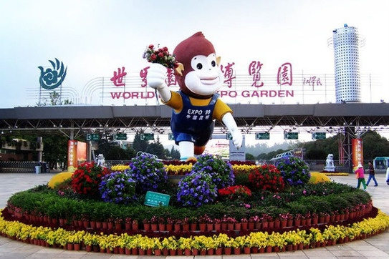
Kunming

Slide 42
Kunming
After reading the text, please circle the right ones from the following statements.
1 The stone forest comprises seven areas of interest.
2 ’99 World Horti-Expo Garden have indoor exhibition areas for
different countries and regions.
3 The three major villages in the Yunnan Nationalities Villages are
Dai, Bai and Zhuang ethnic minorities.
4 Dianchi Lake is solely for tourism without any other industries.
5 Stone Forest is a typical karst formation.

Slide 43
Chinese Tourism
Welcome Aboard:
1 Beijing
2 Xi’an
3 Hangzhou
4 Nanjing
5 Shanghai
6 Kunming
7 Guilin
8 Lhasa
1
2
3
5
8
4
6
7

Slide 44
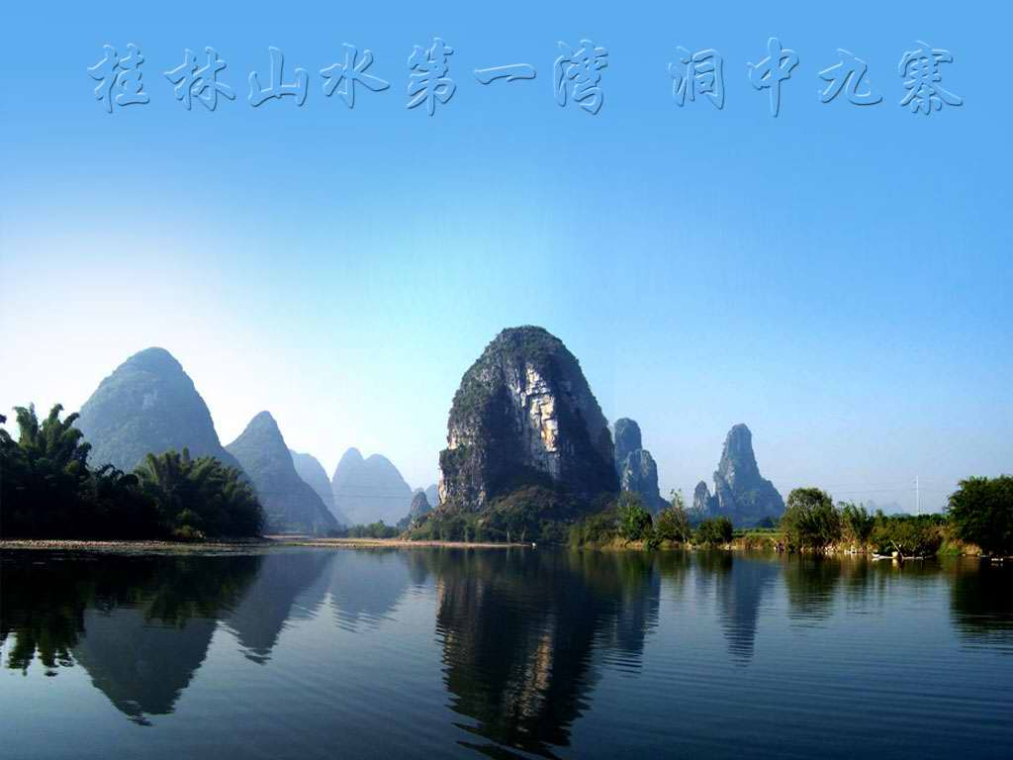
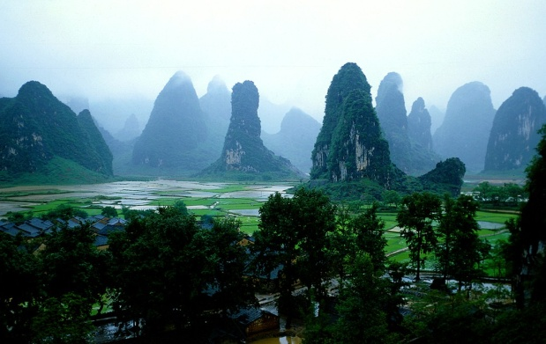
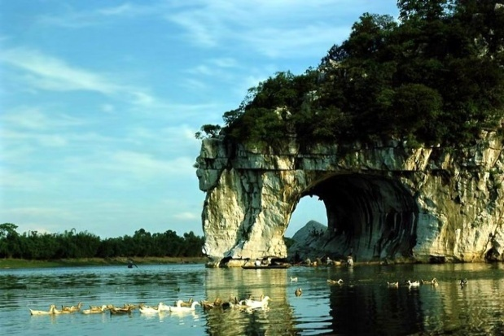
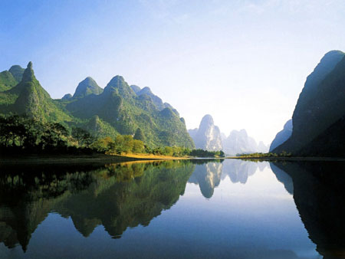
Guilin
After reading the text, now take a breath and enjoy the beautiful scenery of Guilin.

Slide 45
Chinese Tourism
Welcome Aboard:
1 Beijing
2 Xi’an
3 Hangzhou
4 Nanjing
5 Shanghai
6 Kunming
7 Guilin
8 Lhasa
1
2
3
5
8
4
6
7

Slide 46
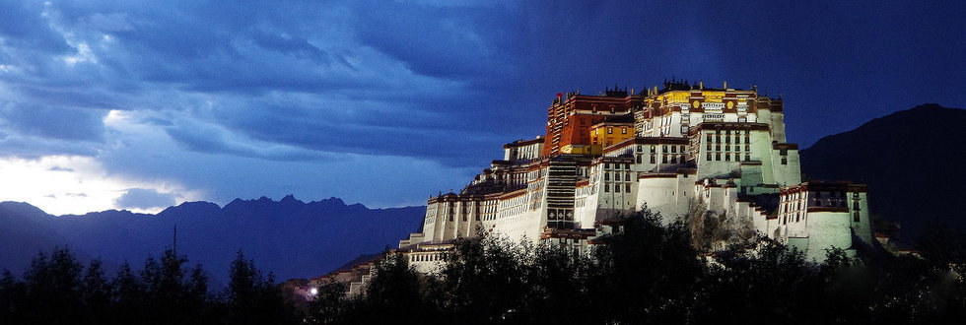
Lhasa
Introduction
one of the highest cities in the world
with an elevation of 3650 meters
features a combination of traditional and modern life

Slide 47

Lhasa
Potala Palace
built by Songtsan Gambo for Princess Wencheng
about 115 metres high with 13 storeys
made of stone and wood
with a large collection of sculptures, murals, scriptures and
other valuable cultural relics

Slide 48
1
2
Overview
3
Lead-in Activity
Chinese Tourism
Discussion &
Presentation

Slide 49

Discussion
The recent online exposure of a teenager from Nanjing who defaced a 3,500-year-old Egyptian temple has provoked nationwide scrutiny of such poor behaviour abroad. Many people said the behaviour had damaged the image of Chinese tourists. Discuss with your partner about other negative behaviour of Chinese tourists and how to exercise good manners when travelling. Then share your ideas with the class.

Slide 50
Discussion
Some Tips for Travelling Abroad
Buy your tickets when commuting through Public
transport though no one checks really but if found
penalties are quite high.
Tips are usually given in restaurants. Around 10-15% of
the bill amount.
Never ever cross road when the signal is Red. Cross the
road only when signal shows crossing sign. Usually,
pedestrians are respected a lot and vehicles will stop to
let you cross.
Don’t deface public properties and put scarves on relics.
Take your trash with you when you are out of a vehicle.

Slide 51

Students’ Presentation
You are a tour guide, and you will receive a group of Australian tourists who will visit Xi’an. Please collect as much information as possible about the city and present as clearly as you can to them.
The Introduction should cover the following points:
1 the general introduction to Xi’an;
2 the famous scenic spots in Xi’an;
3 the local food of Xi’an.

Slide 52
The End

